Slide 1
How Much Should We Trust Differences-In-Differences Estimates?
Bertrand, Duflo, Mullainathan (2004)
Discussion by Jeff Denning

Slide 2
What’s the issue here?
Differences in Differences is super useful and popular
The authors point out that if you test a bunch of fake law changes you’re way too likely to reject the hypothesis that there is no treatment effect.

Slide 3
Why is this?
Autocorrelation--what happened today is really correlated with what happened yesterday
Example: My points in middle school basketball
Typical standard errors assume that every observation is independent.

Slide 4
What do they do?
The look at women’s labor force outcomes.
They assign half of the states to be “treated” and half to be “control”
They pick a year to be the treatment year at random
Then they see how often they find a statistically significant “effect” (How often should they?)

Slide 5
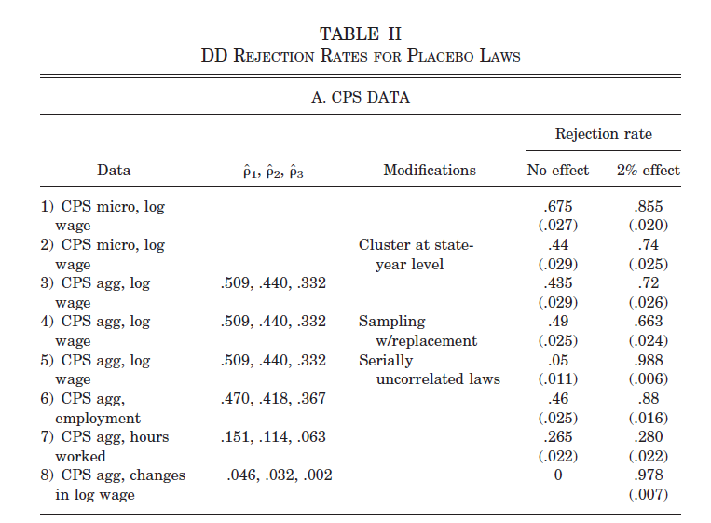
Table 2

Slide 6
Monte Carlo
What does Monte Carlo mean?
“I made up the data”
They can more precisely control the data generating process (DGP).
They can tweak exactly how correlated the data are across time, etc.

Slide 7
Solutions
Estimate how correlated the error terms are across time
Use this to calculate the standard errors.
Still not great

Slide 8
Block Bootstrap
Estimate the model
Resample the model by drawing entire states and their corresponding data at random (with replacement)
Reestimate the model, store estimates (rinse repeat)
The standard error is the standard deviation of bootstrapped estimates

Slide 9
Ignore Time Series Info
Just look before and after
Can be a little fancier by residualizing
Cons: low power

Slide 10
Actual Solution
Cluster your standard errors
Do this at the state level.
(Or block bootstrap)
Can also collapse data to the state-year level and cluster

Slide 11
What does clustering assume?
Observations within a cluster are allowed to be correlated
However, across clusters you assume that the observations are independent
E.g. we allow Illinois in year t to be correlated with Illinois in year t-1, BUT we say Illinois is independent of Indiana

Slide 12
Other contexts
Where else have we worried about this?
In an RCT we need to cluster standard errors to account for correlation among observations
In general, you want the number of clusters to be “large.”
If you have too few clusters, you will overstate the significance of your results.

